Slide 1
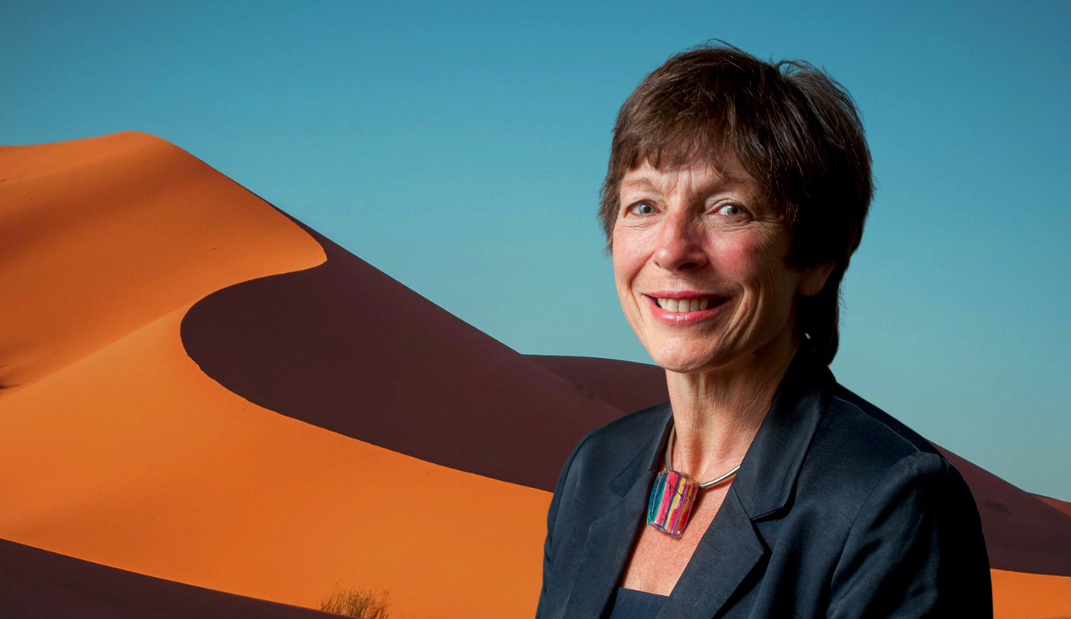
GGI Annual Lecture
Good governance because scarcity is real
Jane Davidson, Chair of Wales Net Zero 2035

Slide 2
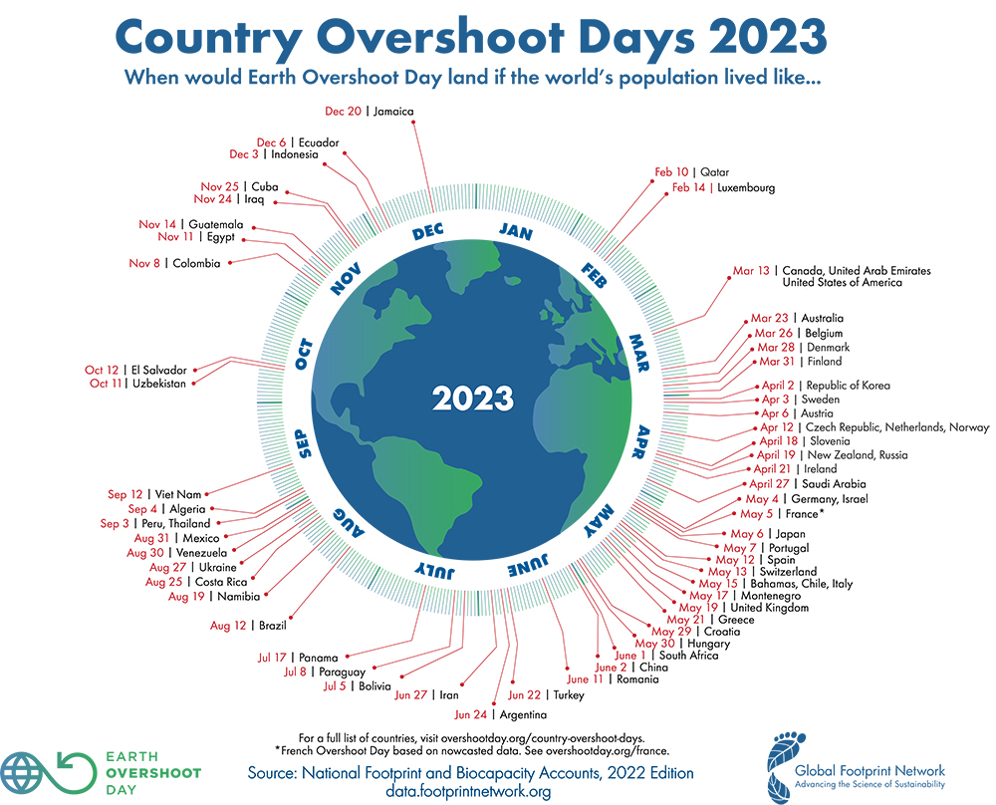
Overshoot days 2023
A country will only have an overshoot day if its Ecological Footprint per person is greater than global biocapacity per person
UK
Source: National Footprint and Biocapacity Accounts, 2022 Edition data.footprintnetwork.org

Slide 3

Section 1
Rethinking our values

Slide 4
1999 – new democracy, new duty for Wales
Government of Wales Act 1998.
The Government has a duty to have a scheme setting out how it will promote sustainable development in the exercise of its functions.
Brundtland definition of 'Sustainable Development’.
“
...development that meets the needs of the present without compromising the ability of future generations to meet their own needs.
”
Notes:
But floods, foot and mouth, no legislative powers, processes not outcomes – tried politically to make it work, but no definitions BUT the idea was really popular

Slide 5

The well-being of future generations (Wales) Act 2015
Long term
Prevention
Collaboration
Integration
Involvement
Globally responsible
Prosperous
Vibrant culture and thriving Welsh language
Resilient
Healthier
Cohesive communities
More equal

Slide 6

Goals
A prosperous Wales
A resilient Wales
A healthier Wales
A more equal Wales
A Wales of cohesive communities
A Wales of vibrant culture and thriving Welsh language
A globally responsible Wales
An innovative, productive and low carbon society which recognises the limits of the global environment and therefore uses resources efficiently and proportionately (including acting on climate change); an economy which generates wealth and provides employment opportunities, allowing people to take advantage of the wealth generated through securing decent work.
A nation which maintains and enhances a biodiverse natural environment with health functioning ecosystems that support social, economic and ecological resilience and the capacity to adapt to change (for example climate change).
A society in which people’s physical and mental wellbeing is maximised and in which choices and behaviours that benefit future health are understood.
A society that enables people to fulfil their potential no matter what their background or circumstances (including their socio-economic background and circumstances)
Attractive, viable, safe and well-connected communities.
A society that promotes and protects culture, heritage and the Welsh language, and which encourages people to participate in the arts, and sports and recreation.
A globally responsible Wales. A nation which, when doing anything to improve the economic, social, environmental and cultural wellbeing of Wales, takes account of whether doing such a thing may make a positive contribution to global well-being, and the capacity to adapt to change (for example climate change).
Notes:
Notes for each goal re successes….

Slide 7
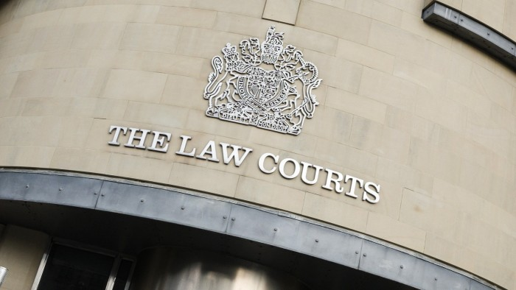
Holding the government/public services to account
The Future Generations’ Commissioner
The Auditor General for Wales
The Courts – through judicial review

Slide 8
Section 2
New governance, new decicions

Slide 9






Recent Government commitments linked to the Well-being Act
Universal Basic Income Pilot for all care-leavers 2022
Agriculture Bill: focus on Sustainable Land Management based on four key objectives: 2023
Source to sea river management 2023
with 5 year clean up programme
Tripling peatland restoration targets 2022
Tidal Lagoon Challenge
June 2023
COP 15 2022 : Government commitment to protecting 30% of land and sea by 2030
20mph speed limit to reduce emissions and improve air quality
3X
30%
20
mph
Ban on smacking children 2021
Roads Review 2021
Welsh road building projects stopped after failing climate review
Net zero Wales 2035 in a just and nature positive way 2021
0
Notes:
Decision on peat restoration
Nature on the board
NRW The Advisory Panel has collaborated on the core question for the Citizens’ Assembly, which is:
“What does the future look like when society and nature thrive together?”
The panel has also helped to provide a shortlist of useful evidence and case studies which, alongside the evidence collected through the national conversation will help the Assembly in their deliberations and recommendations. This will in turn guide the co-development of visions for 2030, 2050, and the steps needed by all of us to get there.

Slide 10

oneplanetstandard.org

Slide 11

How is the Standard different?
When designing The One Planet Standard, we examined other standards, and we have learnt from what they do and don't do:
Firstly, our Standard accounts for the complete impacts of an organisation – its estate, products and services, and operations.
Secondly it accounts for impacts on nature and society as well as carbon emissions.
Thirdly, it enables organisations to set their own targets and KPIs and engage in the process of continuous improvement. It can be used a developmental tool or to obtain the standard itself.
Finally, an independent assessment evaluates progress and whether an organisation is doing in reality what it says it is doing. There is no opportunity for green or whitewash!
NO ONE SIZE FITS ALL

Slide 12

https://netzero2035.wales

Slide 13
Our mandate
The Co-operation Agreement: 2021
A Greener Wales to Tackle Climate Change and the Nature Emergency
“
Commission independent advice to examine potential pathways to net zero by 2035 – the current target date is 2050. This will look at the impact on society and sectors of our economy and how any adverse effects may be mitigated, including how the costs and benefits are shared fairly.
”

Slide 14
Our five Wales Net Zero 2035 challenges
How could Wales feed itself by 2035?
How could Wales meet energy needs by 2035 whilst phasing out fossil fuels?
How could Wales heat and build homes and workplaces by 2035?
How could people and places be connected across Wales by 2035?
What could education, jobs and work look like across Wales by 2035?
Challenges
Net Zero 2035

Slide 15
Our crosscutting 'domains'
Finance
Co-benefits
Engagement & communication
Domains
Nature
Just Transition
International impacts
Education & skills
Circular economy
Futureproofing
Psychology & behaviour
Governance & legal

Slide 16
Our participation model
With relevant stakeholders and the public through the work of our reference groups
Participation
&
Engagement
With partner organisations to test and socialise our conclusions
With Institute of Welsh Affairs to host our citizens assembly
With the Wales Youth Parliament to test our conclusions with young people in Wales

Slide 17
Our framework
Well-being of Future Generations (Wales) Act 2015
Planetary boundaries
Crosscutting domains
Participation & Engagement
Net Zero 2035
Challenges

Slide 18





Our timeline
Jan – Jun 2023
Set up
Jul – Dec 2023
Collection of evidence
Jan – Mar 2024
Synthesis of evidence & development of draft conclusions
Apr – May 2024
Early conclusions tested publicly
Jun – Jul 2024
Finalise report for presentation
Goals, ways of working, challenge setting, challenge reference groups, public participation arrangements, reporting structures
Including open public consultation on challenges – food, energy, buildings, connections, education and the future of work
Including further evidence gathering and testing of draft conclusions
Test early conclusion ideas through citizens’ assembly, Welsh Youth Parliament, partner events, public, private and community sectors
July event to present deliverable pathways to Co-operation Agreement partners at Senedd

Slide 19
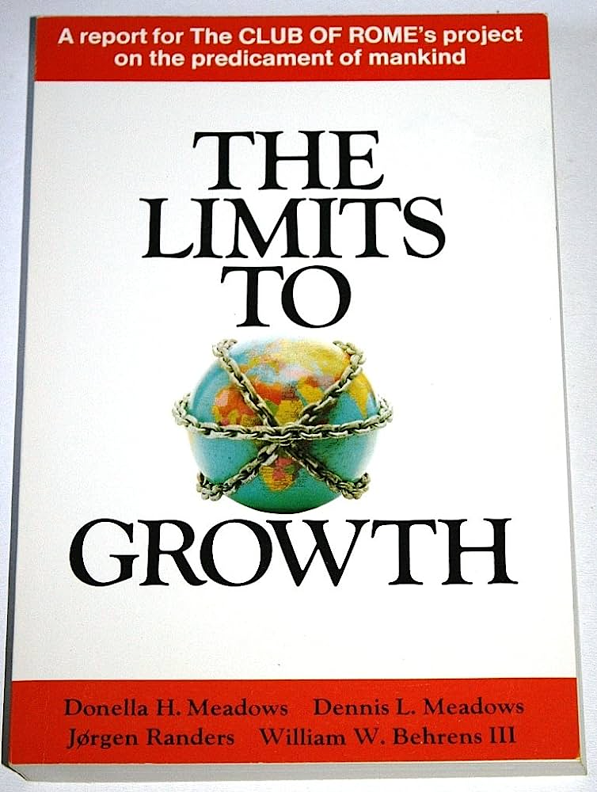
…by demonstrating there is a better way
“
The sustainability revolution will have to be, above all, a collective transformation that permits the best of human nature, rather than the worst, to be expressed and nurtured.
Prof Donella Meadows
The world for all practical purposes has no limits - the result is collapse
The limits are real, there is not enough time - the result is collapse
The limits are real and close but there is no time to waste - a sustainability revolution to a much better world
Notes:
How do we change systems? By demonstrating there is a better way

Slide 20
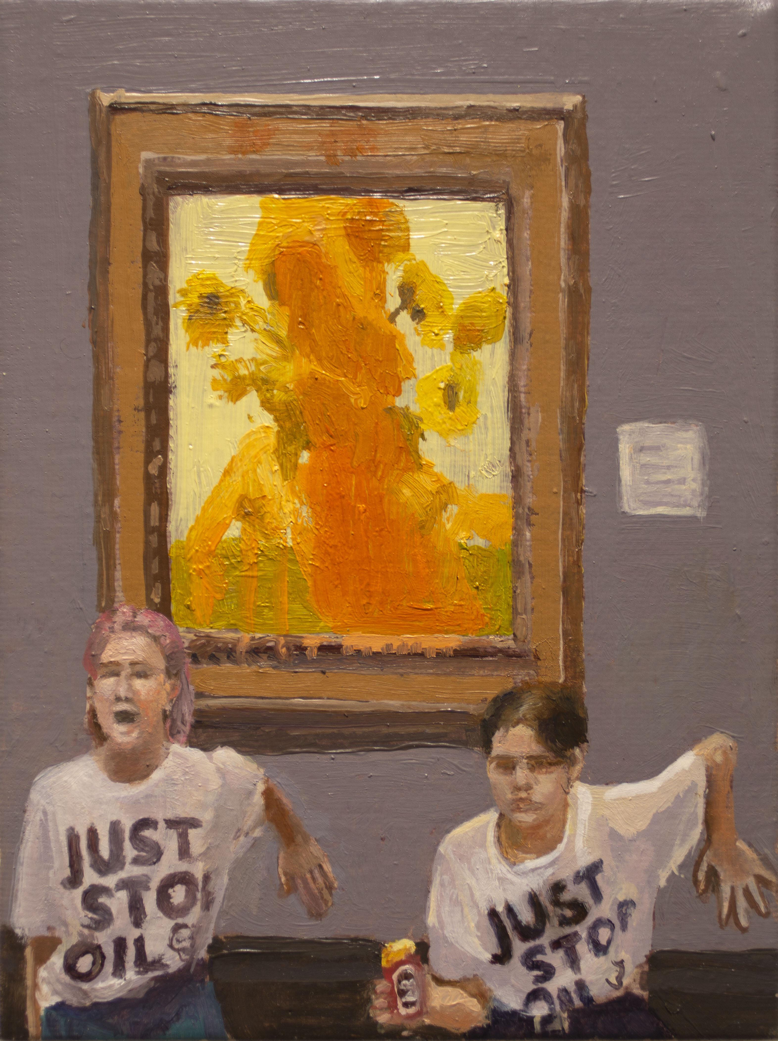
“
Who is holding back more rapid movement to the better society? Who is responsible for the mediocre performance of so many of our institutions? Not evil people. Not stupid people. Not apathetic people. Not the “system”. Not the protestors, the disrupters, the revolutionaries, the reactionaries. The real enemy is fuzzy thinking on the part of good, intelligent, vital people and their failure to lead.
Robert Greenleaf ‘Servant Leadership’ 1979
”

Slide 21
Good governance, new decisions
1
Honest
Evidence-based
Clear and understandable
Fair for current and future generations
Accountable
Meaningful
Ethical
8
Long term
Preventative
Involving people about whom decisions are being made
Integrating outcomes
Collaborative
2
9
3
10
4
11
5
12
6
7

Slide 22
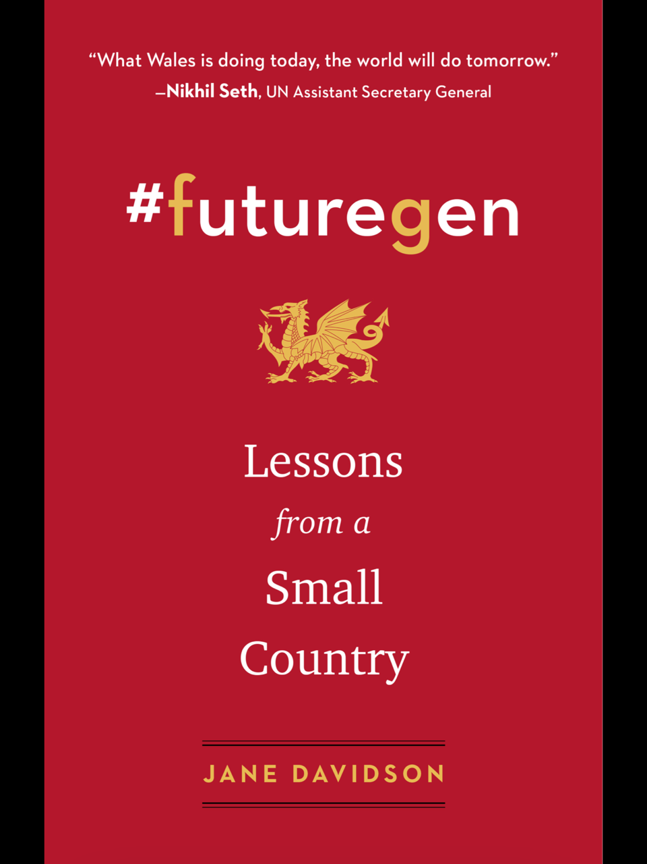
Scotland is planning similar legislation in this parliamentary term. Ireland plans to legislate too
Scotland, Finland, Iceland, Wales, Canada and New Zealand are members of the Wellbeing Economy Governments.
…other countries/cities/organisations are interested in this approach to deliver on the SDGs by 2030.
The first United Nations summit for the future will take place in September 2024!
Jane Davidson
Chair, Net Zero Wales 2035
https://netzero2035.wales/
https://www.janedavidson.wales
@janebryngwyn

